Slide 1
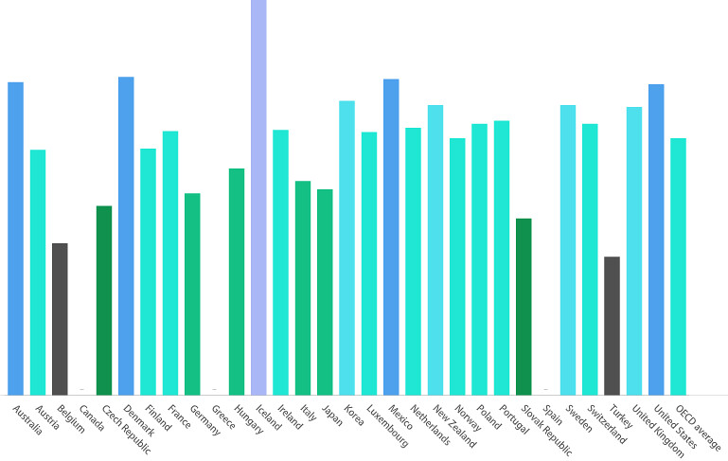
The Great Resignation Analysis
Contributing Members:
Gus Sanchez
Marc Palumbo
Roxann Lopez
Heather Bailey
Notes:
Heather - Hello everyone! Welcome to The Great Resignation Analysis! I'm Heather Bailey, and our group members are Gus Sanchez, Marc Palumbo, and Roxann Lopez.

Slide 2



Topic Selection
Notes:
Heather - What is the Great Resignation? An ongoing economic trend in which employees have voluntarily resigned from their jobs en masse, beginning in early 2021 in the wake of the COVID-19 pandemic.

Slide 3




Background
Manufacturing
Healthcare
Education
Notes:
Heather - Many have speculated as to why individuals have become more willing to leave their current employers, and we hope to provide some evidence and possibly some answers for this after analyzing the data we have discovered. For our project, we will be focusing on the U.S. workforce, primarily in the manufacturing, healthcare and hospitality, and education sectors.

Slide 4

Motivation
Relevance
Widespread Impact
Personal Impact
Future Implications
Notes:
Heather - I bet the majority of us have contemplated quitting a job at one point or another. As we progress through our analysis, I’d like you to think about why. Was the commute unbearable? Was the pay not worth it? Was it a toxic work environment? There are a multitude of reasons for resignations, we will explore a few of those. We chose this topic as a group because the onset of the Great Resignation has individually motivated each of us to pursue alternate career paths and we have personally been affected by this economic trend, as I’m sure many of you have.Understanding the contributing factors to the Great Resignation will enable us to better predict future economic trends.

Slide 5




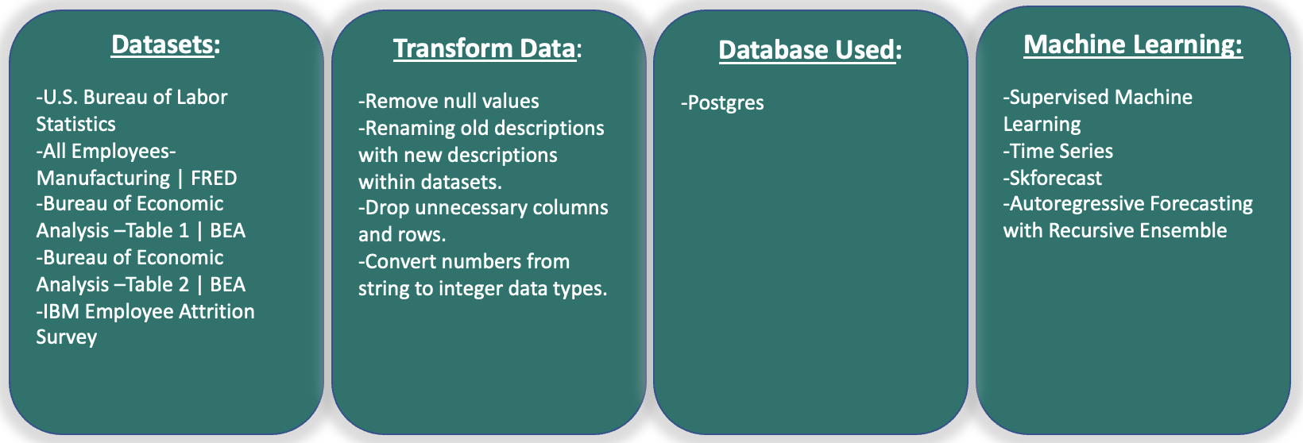
Data Sources
All Employees- Manufacturing | FRED
BEA | Bureau of Economic Analysis Table
BEA | Bureau of Economic Analysis Table 2
U.S. Bureau of Labor Statistics
Kaggle | HR Analytics Attrition
Notes:
Heather - We used multiple data sets for our analysis. We performed ETL and created visualizations from the Kaggle dataset on Attrition and the economic data from FRED, and used the Bureau of Economic Analysis tables for our machine learning portion.

Slide 6
Questions we hope to answer:
?
What are the contributing factors to individuals resigning from their jobs?
What will future U.S. economic trends look like?
What industries will be most impacted in the future by resignations?
Notes:
Heather - The questions we set out to answer were: What are the contributing factors to individuals resigning from their jobs? What will future U.S. economic trends look like? And What industries will be most impacted in the future by resignations?

Slide 7

Employee Attrition
The Five R’s
Retirement
Relocation
Reconsideration
Reshuffling
Reluctance
Notes:
Roxann - Employee attrition measures how many workers are voluntarily or involuntarily leaving their jobs for many reasons. During the COVID-19 pandemic, there was a mass exit in the workforce that is widely known as the Great Resignation. There are various contributing factors, but they can be broken down into five categories known as The Five R’s. Retirement, relocation, reconsideration, reshuffling, reluctance.

Slide 8

Retirement
Notes:
Roxann - Older employees retiring at accelerated rates during pandemic. Some even retiring early.

Slide 9

Relocation
Notes:
Roxann - People relocating from larger cities to smaller ones in hope for less stressful lifestyle.

Slide 10

Reconsideration
Notes:
Roxann - People quitting their jobs as their values no longer align with the companies. Toxic work cultures.

Slide 11

Reshuffling
Notes:
Roxann - Employees are searching for better wages, location, company work culture, and flexibility with work hours.

Slide 12

Reluctance
Notes:
Roxann - Work from home has become the new normal during pandemic. Individuals do not want to work in the office any more. Better work/life balance.

Slide 13
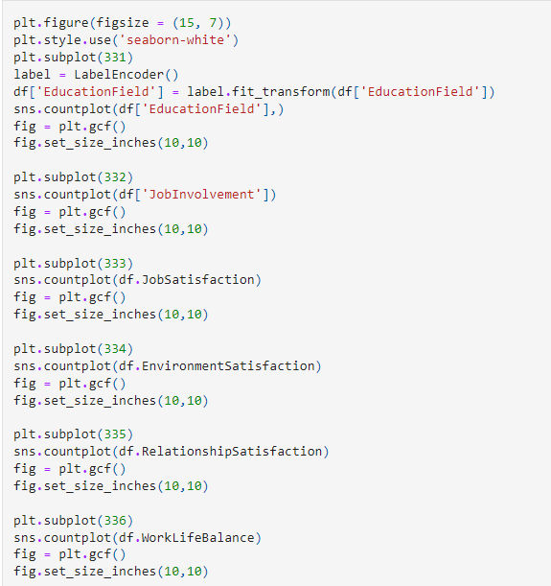
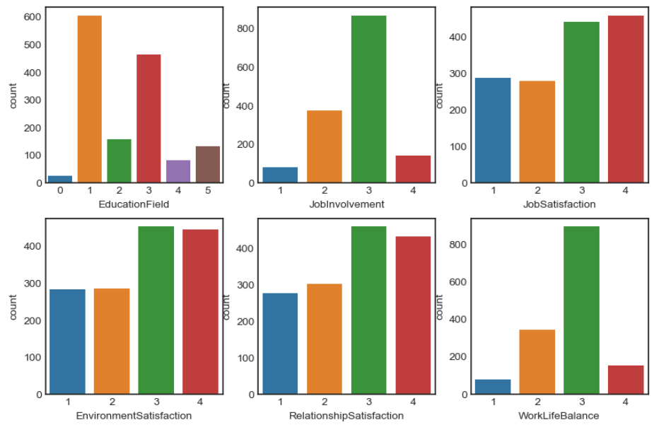
IBM Employee Survey
Data exploration phase: person 1 present
Notes:
Roxann - IBM surveyed approx 1400 of their employees.
Here are 6 subplots of the data provided from that survey.
Education Field: (1) Below College, (2) College, (3) Bachelor, (4) Master, (5) Doctor
Job Involvement, Job Satisfaction, Environment Satisfaction, & Relationship Satisfaction: (1) Low, (2) Medium, (3) High, (4) Very High
Work/Life Balance: (1) Bad, (2) Good, (3) Better, (4) Best

Slide 14
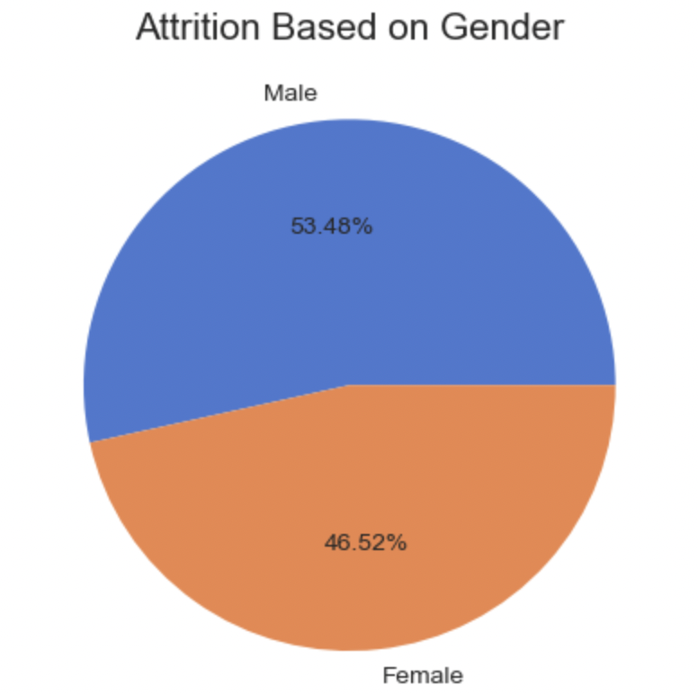
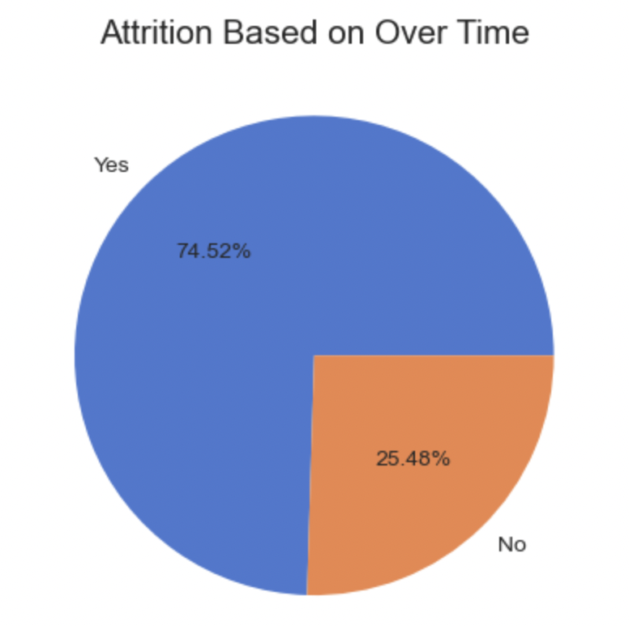
IBM Employee Survey
Notes:
Roxann - Men are experiencing attrition more than women, overtime plays a big factor in discontent.

Slide 15
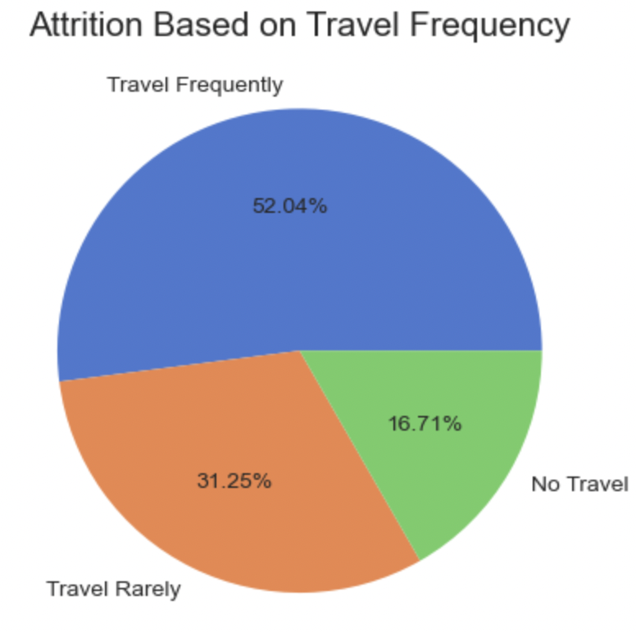
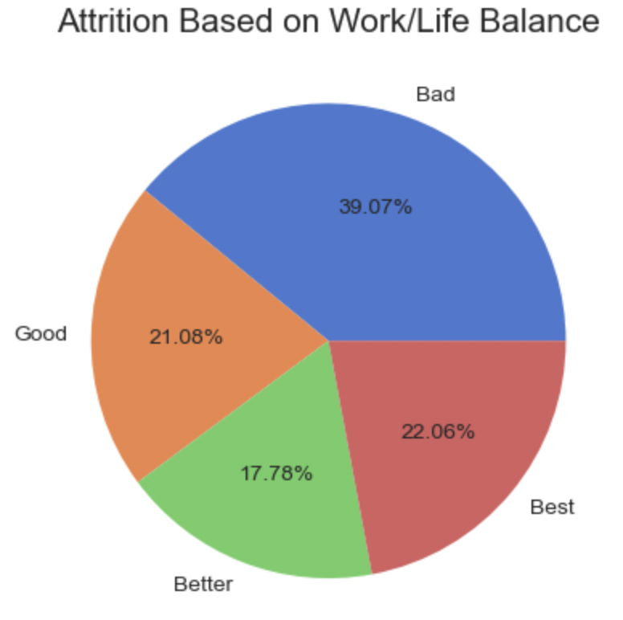
IBM Employee Survey
Notes:
Roxann -spending more time away from home causes employees to experience attrition.

Slide 16
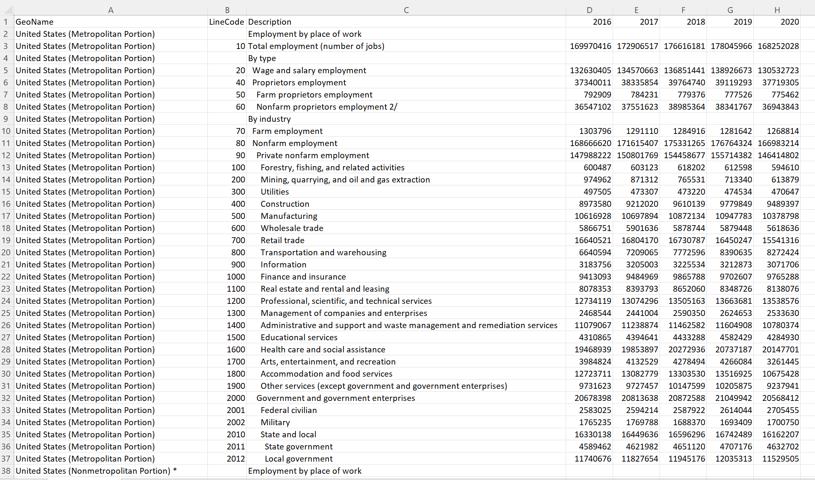
Data Cleaning / ETL
Raw Geographic Data
Notes:
Marc - Introduce self as database administrator and mention how you help transform set
Explain how we thought dataset was more usable than it actually was
Mention unnecessary column, bad formatting, and summary columns in raw data set
Transition to clean data slide
I am Marc, primarily responsible for the ETL process and database creation and connecting to our models - ROLE CIRCLE
Pictured is raw data
What we thought
Only delete certain columns, format data types
Actually wrong
Things that were wrong:
All the united states data we’re duplicates of previous information
LineCode was unnecessary for our purposes
Description had summary data and major formatting issues with indents and random characters (move to next slide)
Describe the problem with the summary data. That totaled all the rows under it, and how we sought help in attacking the issue in the following slide

Slide 17
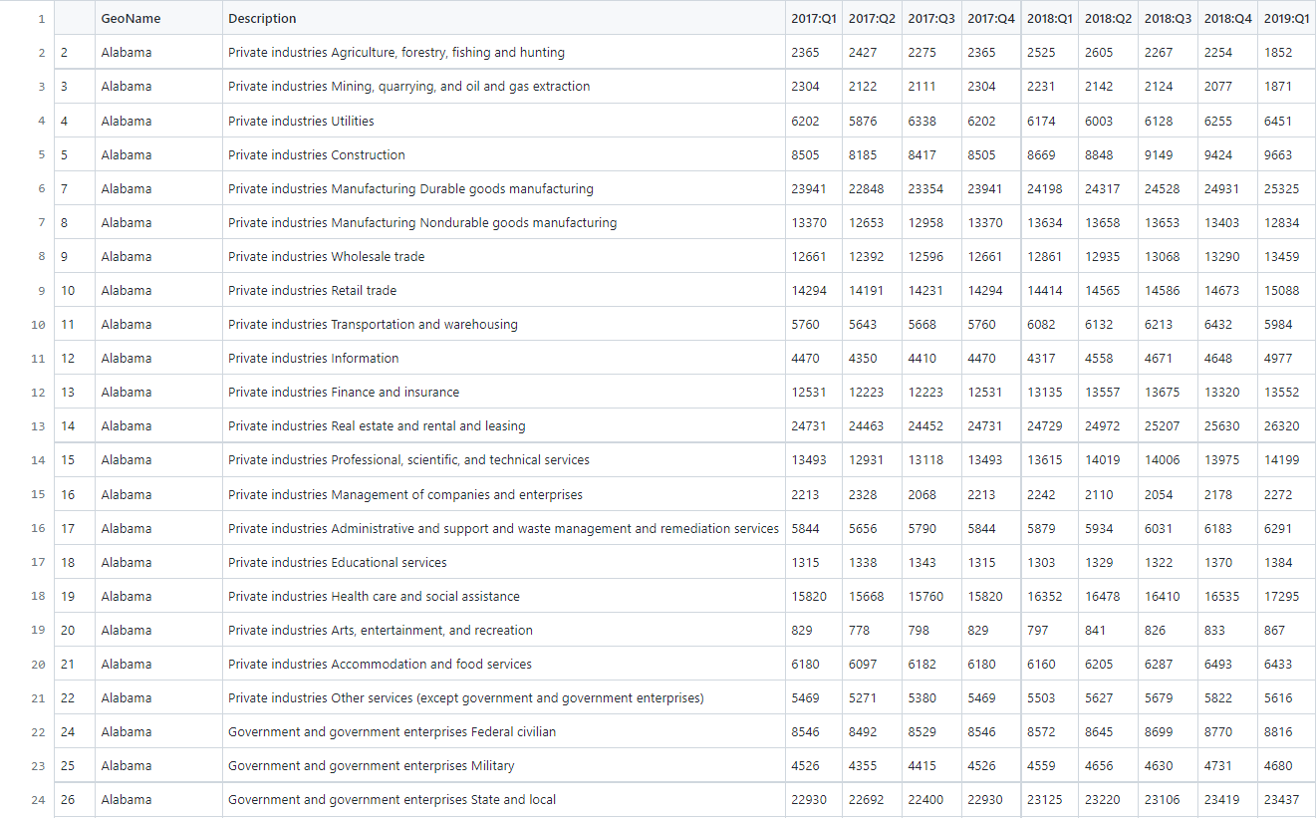
Data Cleaning / ETL
Cleaned Geographic Data
Notes:
Marc -

Slide 18
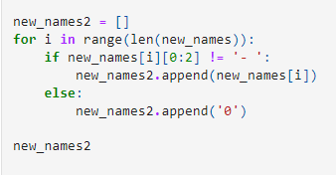
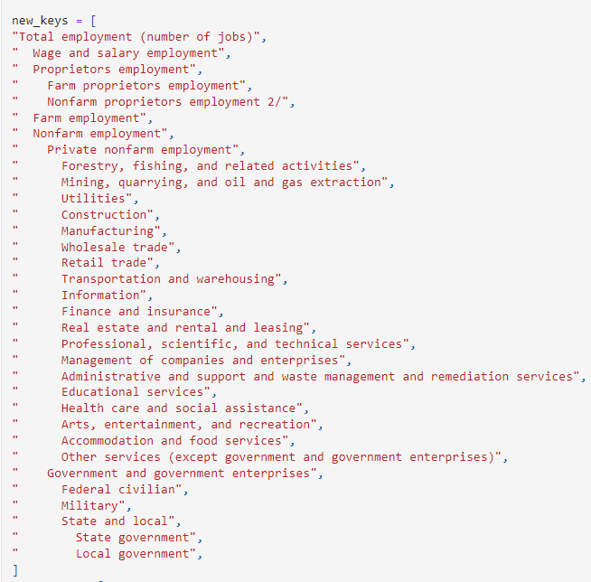
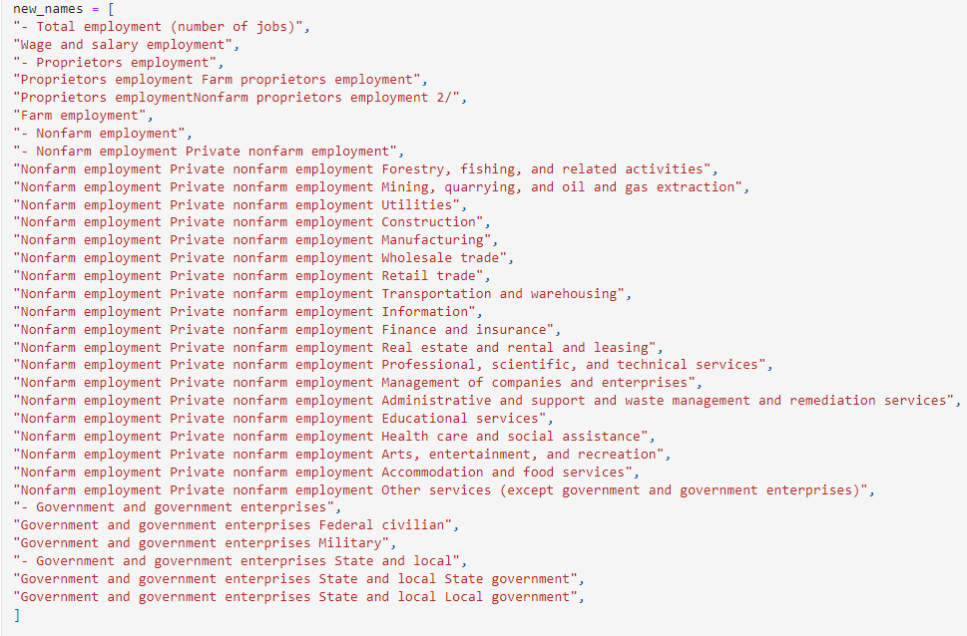
Data Cleaning / ETL
Notes:
Marc - (Describe)

Slide 19
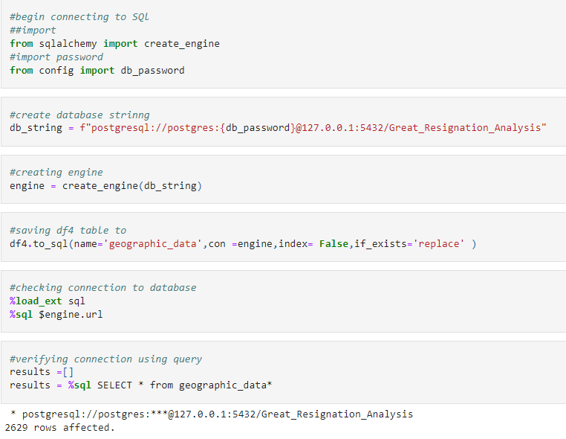
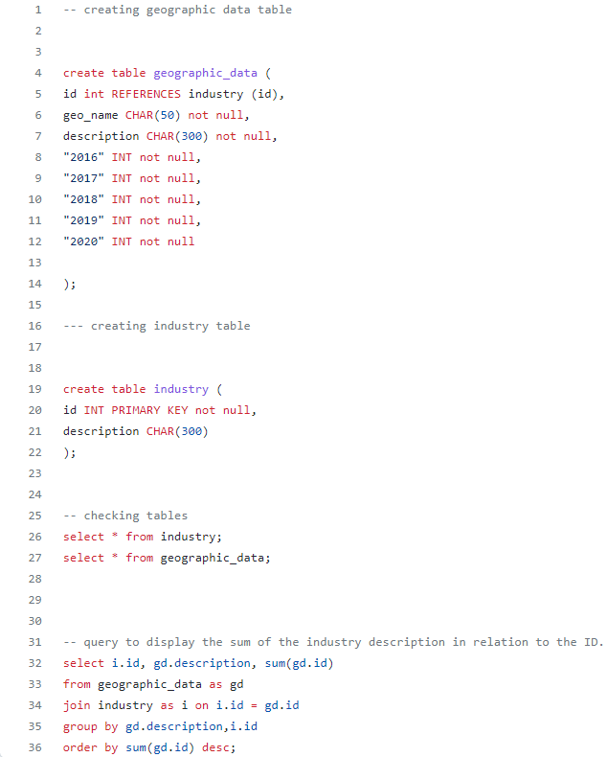
Database / SQL
Notes:
Marc - (Describe)

Slide 20
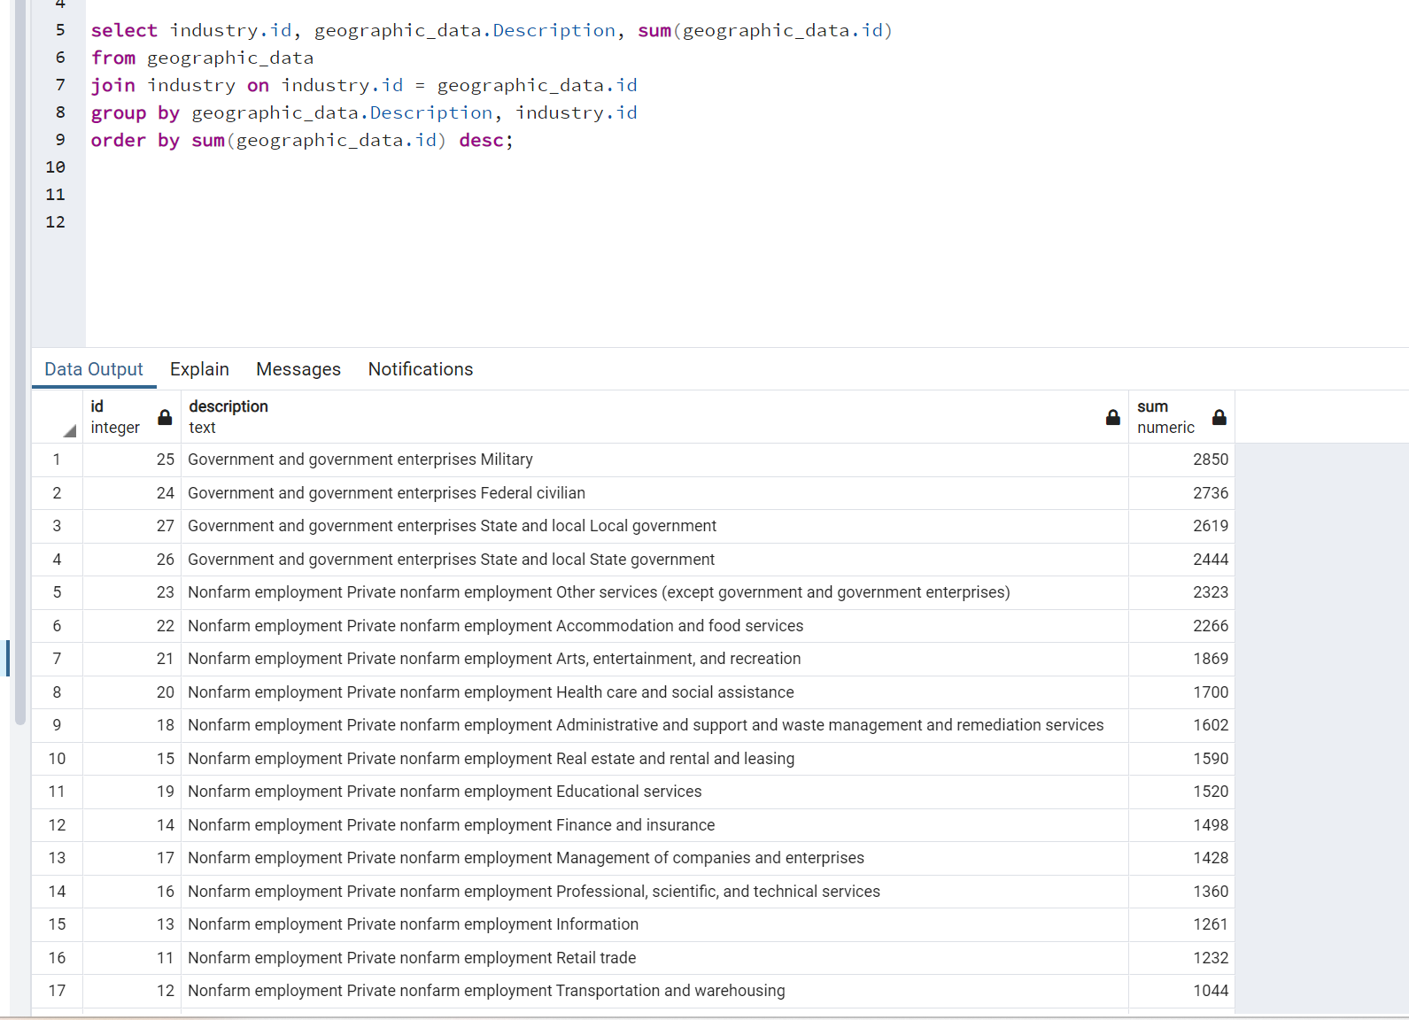
Database / SQL
Notes:
Marc - (Describe)

Slide 21
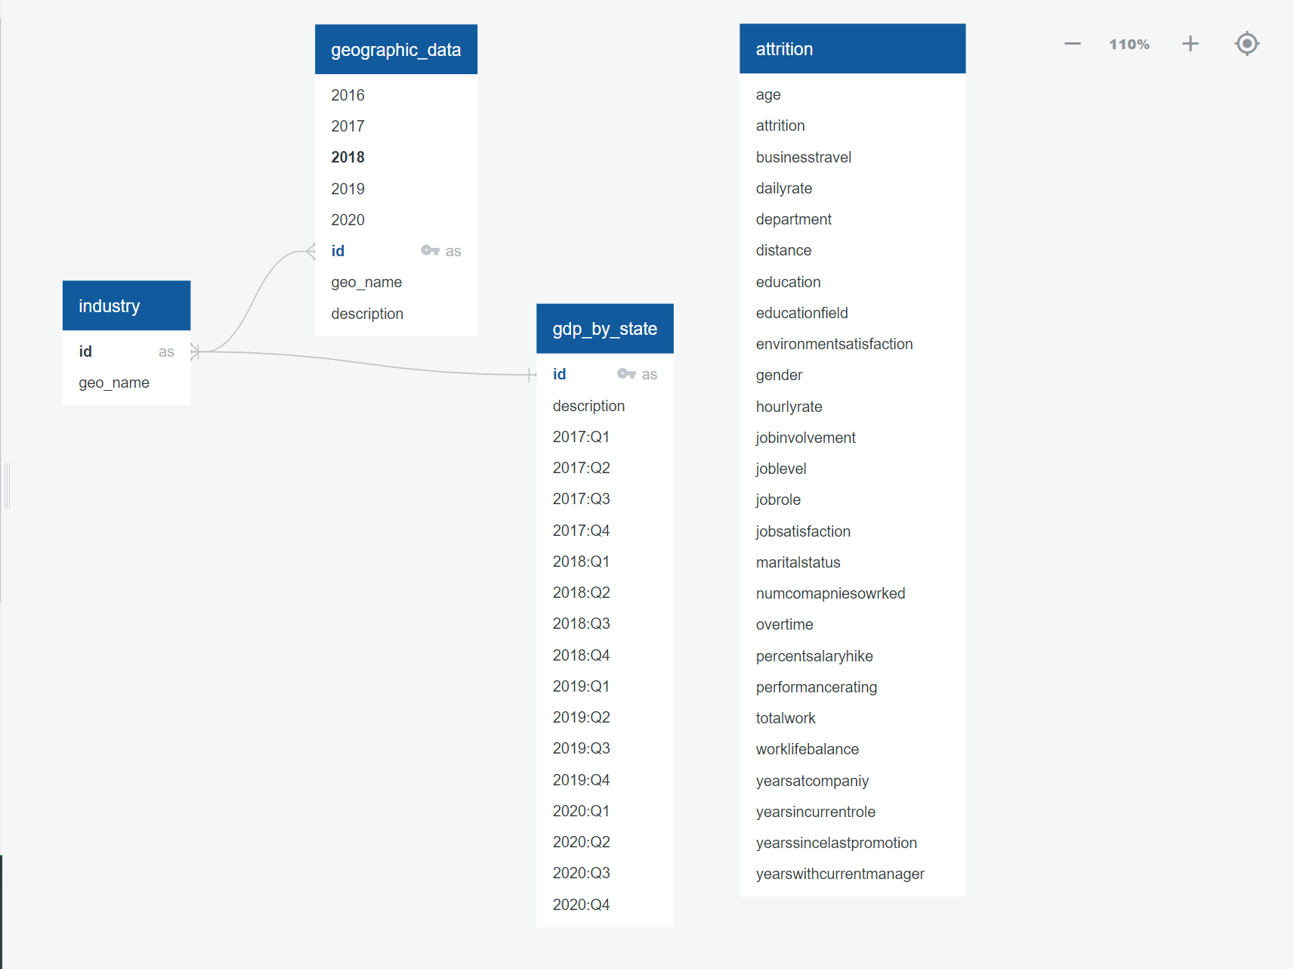
Database / SQL
Notes:
Marc - (Describe)

Slide 22
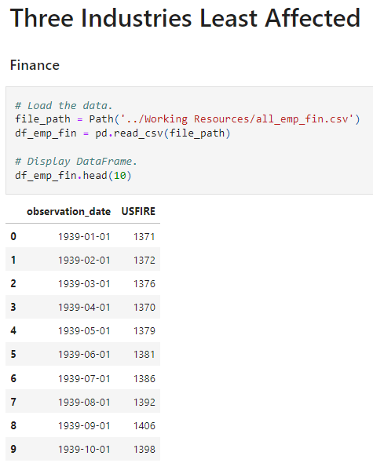
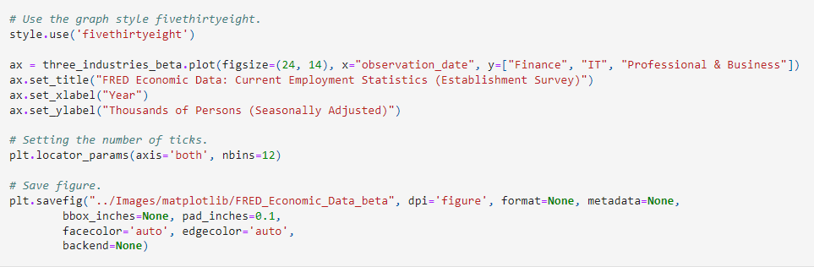
Data Cleaning / Visualization
Notes:
Hello everyone, my name is Gus and I was primarily in charge of the Machine Learning portion as well as the Tableau portion of our project for the Great Resignation
For the exploratory portion of our project I used matplotlib and the graph style fivethirtyeight for historical analysis purposes of the three industries most affected and least affected during the Great Resignation.
The data that was used and collected for this portion was from the Federal Reserve Economic Data at St. Louis

Slide 23
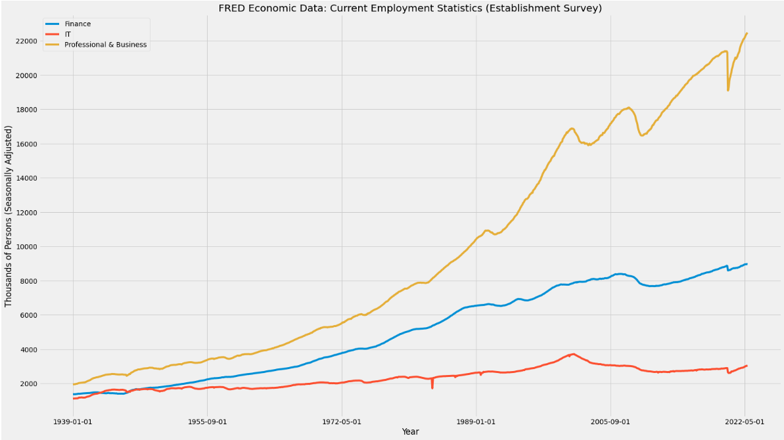
Notes:
The industries least affected during this time period are Finance, IT, and Professional & Business in which all three with the slight exception of Professional & Business took a slight dip during the start of the pandemic to which it quickly rose again with factors such as the rise in remote work.

Slide 24
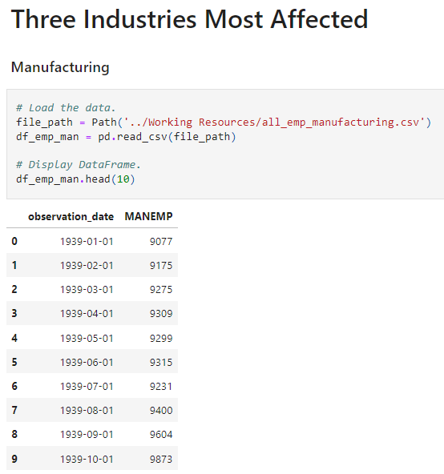
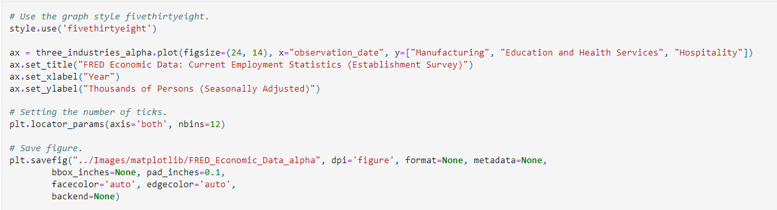
Data Cleaning / Visualization
Notes:
The industries most affected during this time period are Manufacturing, Education and Health Services, and Hospitality.

Slide 25
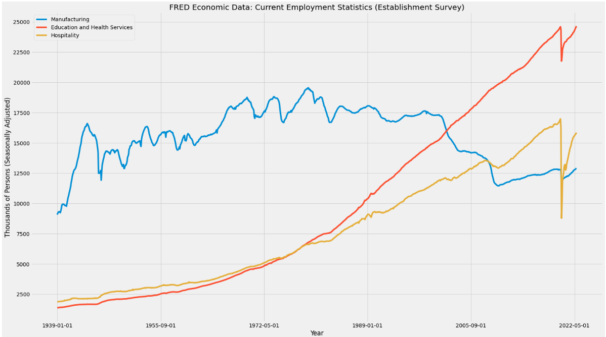
Notes:
All three industries took a massive toll and dip during the Great Resignation and it has only been the beginning of 2022 in which these industries are slowly recovering with the exception of Manufacturing

Slide 26
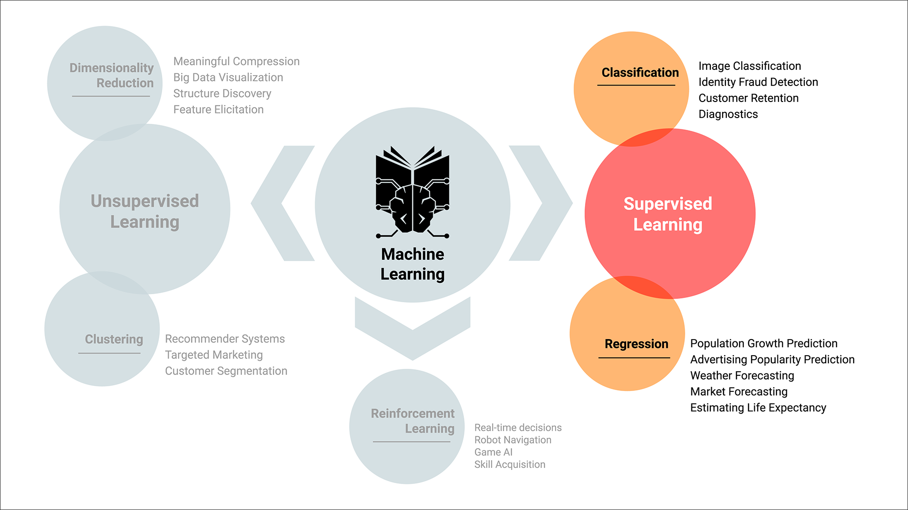
Machine Learning
Notes:
During the implementation and exploratory stage of our Machine Learning model, we initially had planned to use regression models but it became soon apparent that our question we hoped to have answered is a time series related problem. For that reason our group then shifted our interest to time series forecasting models. For this reason we decided to use Skforecast that is a python library that eases using scikit-learn regressors as multi-step forecasters.

Slide 27
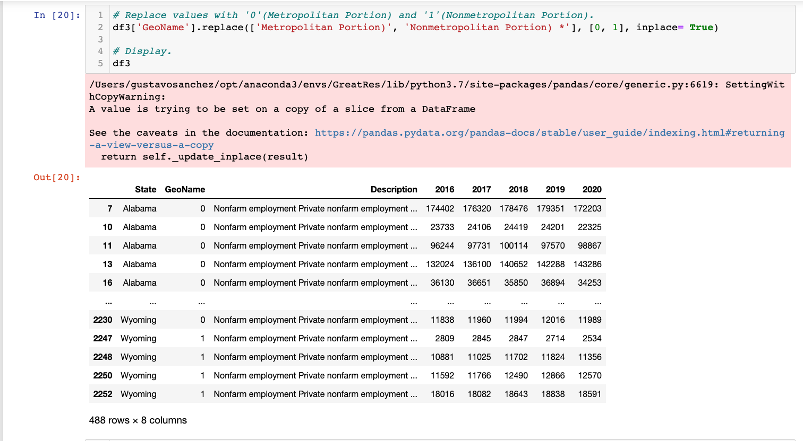
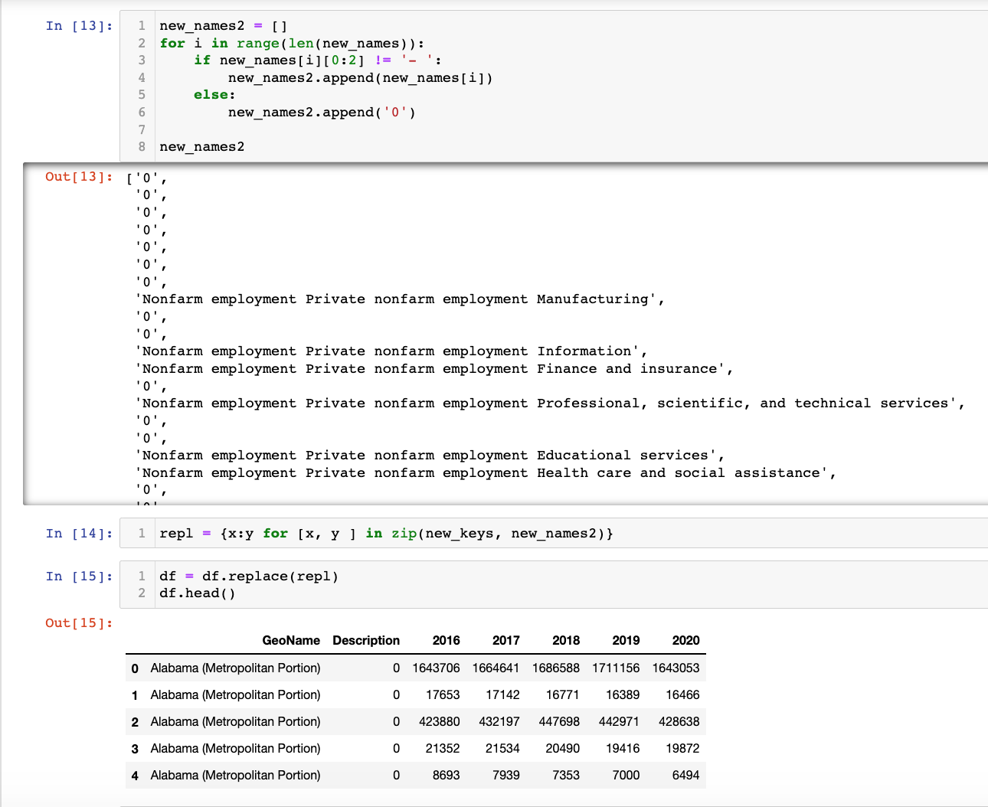
Machine Learning
Notes:
Incorporated the python zip() function for parallel iteration to have a new DataFrame with the six desired industries for forecasting.
Split the GeoName column to Metropolitan portion and Nonmetropolitan portion.
Reorder of columns in the new DataFrame.
Label encode Geoname column with '0' being for Metropolitan portion and '1' for Nonmetropolitan portion.
Created a new DataFrame with pandas iterrows() method to generate an iterator object of the DataFrame, in this case generating a Year column for time series forecasting.

Slide 28
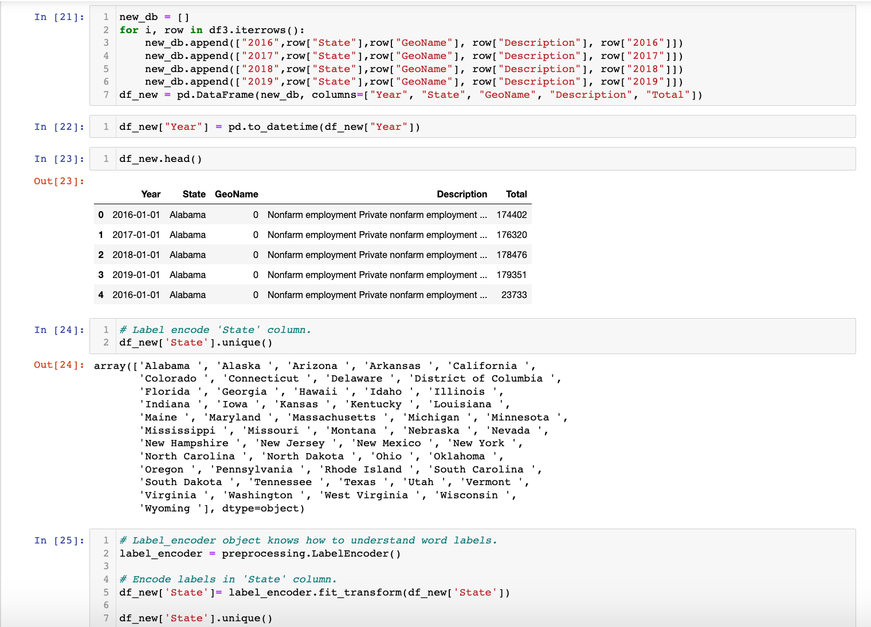
Machine Learning
Notes:
Converted the new 'Year' column from a scalar, array-like, Series or DataFrame/dict-like to a pandas datetime object.
Label encode the State column.
Label encode the Description column.
Reindex the Year column as a index.

Slide 29
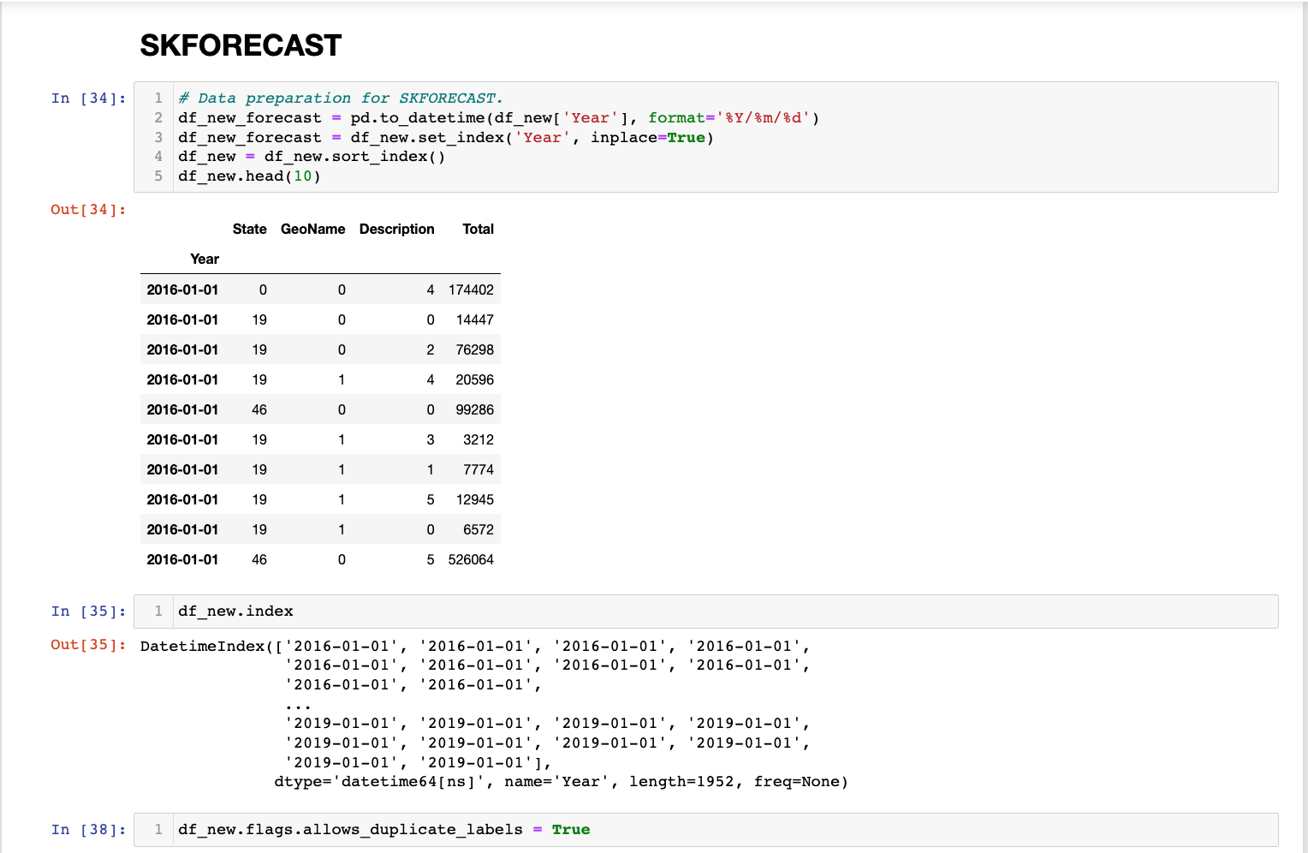
Machine Learning
Notes:
We decided to use Recursive autoregressive forecasting and ForecasterAutoreg that inputs frequency distribution.

Slide 30
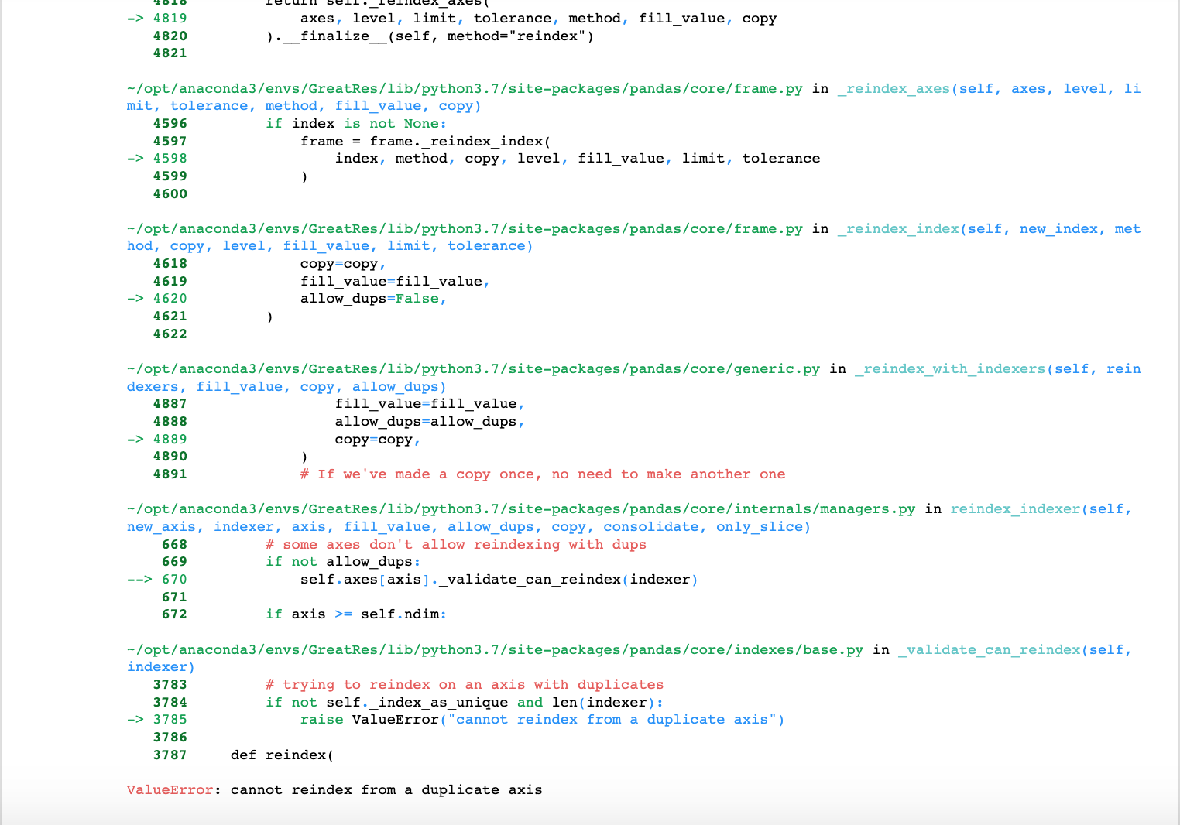
Machine Learning
!
!
Notes:
One of the main challenges of this project was with the original Year index having duplicate values and in order to use Skforecast the frequency has to be set as 'AS' or beginning of the year with unique values.

Slide 31
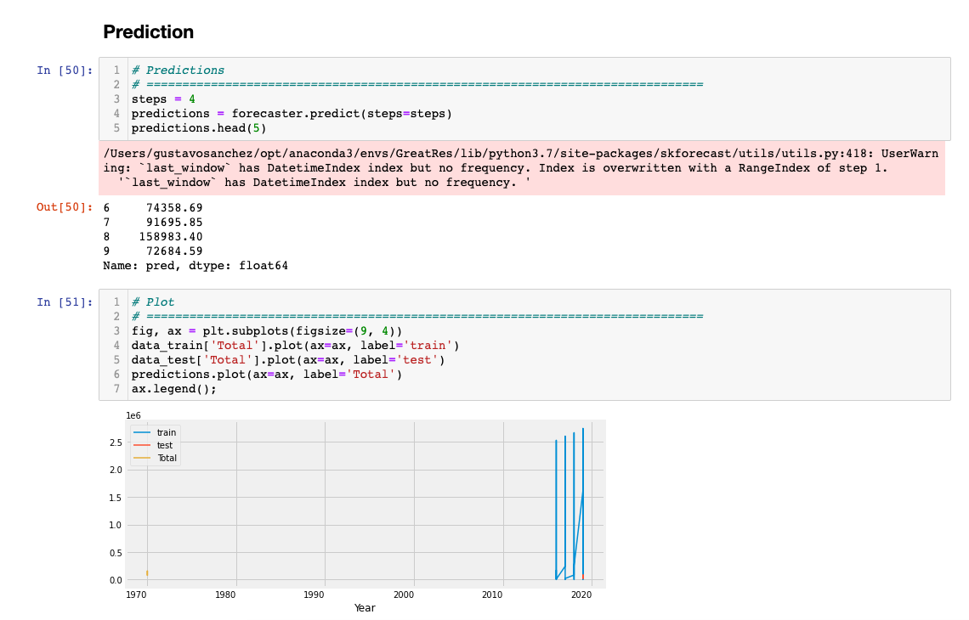
Machine Learning
Notes:
The last portion to bypass the value error was to input an iterrow function to the “Year” column to input milliseconds to give unique values for each column.
We then split our data into our train and test model dates and then inputted it into Skforecast and plotted our prediction for our six industries for forecasting.

Slide 32
Tableau
Link to Dashboard

Slide 33
Conclusion & Future Recommendations
What would be do differently?
Research topic thoroughly beforehand
Don’t make assumptions
Have resource data that has time series associated with it
Notes:
Heather - We set out to find a correlation between certain factors like length of commute, age, education level, marital status, etc. and rates of resignation. We encountered a few obstacles along the way, including a lack of appropriate data, and some challenges with the machine learning portion. In the future, we would research the topic more thoroughly beforehand, don’t make any assumptions, and have resource data that has time series associated with it.

Slide 34
Technologies & Languages
Python SKForecast
SQL Quickdatabasediagrams.com
Postgres Git
Jupyter Notebook Sklearn
Matplotlib Tableau
Pandas VS Code
Notes:
We utilized python, Pandas, SQL, Jupyter Notebook, Postgres, SKForecast, Matplotlib and Tableau.

Slide 35

Questions?

